Slide 1

SMART DOCUMENT
SEARCH SYSTEM
Data Structures & Algorithms — PBL Review
Fast, Fuzzy & Explainable Document Retrieval
Team: Utkalika P. C • Ambika Naidu • Kavitha Reddy • Divya Sri
Guide: Dr. P. Anitha
Department: Artificial Intelligence & Data Science
College: KLH UNIVERSITY

Slide 2
Introduction
01
Background
Need for the Project
Project Direction
Users often remember the content of a document rather than its filename. Traditional exact search can miss relevant documents when wording changes or a query contains spelling errors.
A classroom-scale retrieval engine is needed to demonstrate how core DSA techniques can work together: indexing, exact string matching, fuzzy matching, suffix structures and transparent ranking.
The prototype provides ranked, explainable results over a TXT corpus without depending on a ready-made search library. Each result exposes algorithm-level evidence.
Smart Document Search System • PBL Review • 2

Slide 3
Problem Statement
02
• Traditional search depends heavily on filenames, exact keywords or manual tags.
• Brute-force scanning becomes expensive as the document collection grows.
• Users may remember content but not the filename.
• Misspelled or approximate queries can be missed by exact matching.
• Problem addressed: build an explainable retrieval system that combines multiple DSA techniques to find and rank relevant documents.
Smart Document Search System • PBL Review • 3

Slide 4
Objectives
03
Build
Match
Fuzzy
Build the search engine from the ground up in Java.
Apply advanced string-search algorithms for reliable matching.
Use dynamic programming for approximate / misspelled queries.
Similarity
Index
Explain
Use suffix structures to add similarity evidence.
Build custom indexing and storage structures.
Return ranked results and show why each result matched.
Smart Document Search System • PBL Review • 4

Slide 5
Literature Review
04
Related work / idea | Contribution | Limitation addressed by this project
KMP string matching | Linear-time exact pattern search | Exact matching alone misses spelling variation
Rabin–Karp | Rolling-hash pattern matching | Provides an independent exact-match path
Levenshtein distance | Edit-distance based fuzzy matching | Handles insertions, deletions and substitutions
Suffix array + LCP | Efficient suffix ordering / prefix comparison | Adds similarity evidence beyond exact keywords
Information retrieval systems | Ranking and indexing concepts | Prototype keeps the ranking heuristic transparent and DSA-focused
Key gap: many practical search systems hide the underlying algorithms; this project makes the DSA contribution visible and explainable.
Smart Document Search System • PBL Review • 5

Slide 6
Proposed System
05
• Dependency-free Java prototype for retrieving relevant TXT documents.
• Custom inverted index generates candidate relevance signals.
• KMP and Rabin-Karp detect exact phrase occurrences.
• Levenshtein edit distance provides fuzzy similarity for approximate queries.
• Suffix Array + Kasai LCP provides prefix/similarity evidence.
• Weighted, transparent relevance scoring ranks results and exposes the evidence behind each result.
Key Feature
Explainable ranking: score + term coverage + exact matches + fuzzy similarity + suffix evidence.
Key Feature
Algorithm comparison: actual System.nanoTime() measurements across implemented methods.
Key Feature
Browser interface for search, comparison, algorithm guide, DP alignment lab and document addition.
Smart Document Search System • PBL Review • 6

Slide 7
System Architecture
06
Custom Inverted
Index
Document Files
(.txt)
File Loader +
Text Normalizer
Suffix Array +
Kasai LCP
Matching Layer
KMP • Rabin-Karp
Edit Distance • Suffix
Transparent
Relevance Score
Ranking
Insertion Sort
Explainable Result
Score • Evidence • Preview
User Query
Normalize + Tokenize
Smart Document Search System • PBL Review • 7

Slide 8
System Architecture — Component Description
06
Component | Role
File Loader | Reads the current TXT corpus and newly added TXT documents.
Text Normalizer | Normalizes and tokenizes document/query text.
Custom Inverted Index | Maps normalized terms to document IDs using custom hash-table/postings structures.
Suffix Array + Kasai LCP | Stores suffix order and LCP evidence per document.
Search Engine | Combines exact, fuzzy and suffix signals.
Ranking | Uses a project-specific weighted score and custom insertion sort.
Web Server / UI | Exposes search, compare, guide, DP lab and add-document workflows.
Smart Document Search System • PBL Review • 8

Slide 9
Methodology
07
1
Ingest TXT files from docs/.
5
Generate matching evidence using KMP, Rabin-Karp, edit distance and suffix similarity.
2
Normalize and tokenize document text.
6
Combine signals using the transparent relevance heuristic.
3
Build the custom inverted index and per-document suffix structures.
7
Rank returned results using insertion sort.
4
Normalize and tokenize the user query.
8
Display score, evidence and a preview for verification.
Smart Document Search System • PBL Review • 9

Slide 10
Algorithms / Techniques Used
08
Technique | Purpose | Complexity
Custom Inverted Index | Term → document IDs; candidate retrieval | Expected O(1) per term lookup
KMP | Exact phrase search with failure function | O(n + m)
Rabin-Karp | Rolling-hash phrase matching + verification | Expected O(n + m)
Levenshtein DP | Fuzzy / misspelling similarity | O(nm)
Suffix Array + Kasai LCP | Suffix ordering and prefix similarity | Build O(n log²n) practical; LCP O(n)
Insertion Sort | Ranks returned results by score | O(r²)
Smart Document Search System • PBL Review • 10

Slide 11
Relevance Scoring
08
45
Term coverage
25
Exact phrase
15
Suffix-prefix
15
Fuzzy similarity
10
Exact-match boost
Project-specific heuristic
• Designed for transparent demonstration and evaluation, not claimed as a universal IR metric.
• Fuzzy similarity is computed term-by-term against the closest document token.
• Results expose the signals used, making the ranking explainable during the viva.
Smart Document Search System • PBL Review • 11

Slide 12
Tools & Technologies
09
Programming Language
Software
Data & Corpus
Java (JDK 17+). Core implementation is dependency-free and exposes the DSA logic directly.
Java compiler/runtime, file I/O, HTTP server, HTML/CSS/JavaScript browser UI.
Seven sample TXT documents covering machine learning, data structures, network flow, renewable energy, database indexing, traffic signals and Japanese notes.
Hardware Requirements
Interface
Implementation Scope
Any standard development laptop/desktop capable of running JDK 17+ and a modern browser; no special accelerator is required.
Current project includes a browser UI plus the Java search engine; the original Swing/console scope is also retained in the codebase.
Runnable ingestion is TXT-based. PDF/DOCX/OCR are explicitly future ingestion adapters, not claimed as implemented.
Smart Document Search System • PBL Review • 12

Slide 13
Implementation — Modules Developed
10
Core Search
Indexing
SearchEngine, DocumentStore, Document, SearchResult, ResultList
HashTable, Postings, StringList, custom dynamic structures
Exact Matching
Fuzzy Matching
NaiveSearch, KMP, RabinKarp, ZSearch
EditDistance, AlignmentDP
Suffix Structures
Multi-pattern
SuffixArray + Kasai LCP
AhoCorasick
Benchmarking
Web Layer
BenchmarkService; actual System.nanoTime() comparisons
WebServer + index/compare/guide/lab/add HTML pages + CSS/JS
Smart Document Search System • PBL Review • 13

Slide 14
Implementation — Working Process
10
Load TXT
Normalize
Index
Query
Match
Score
Rank
Explain
• Example exact query: “machine learning” → strong term coverage + KMP/Rabin-Karp evidence.
• Example fuzzy query: “machine lerning” → Levenshtein similarity keeps the relevant report visible.
• Each result shows score, evidence and preview so the user can verify the match.
Smart Document Search System • PBL Review • 14

Slide 15
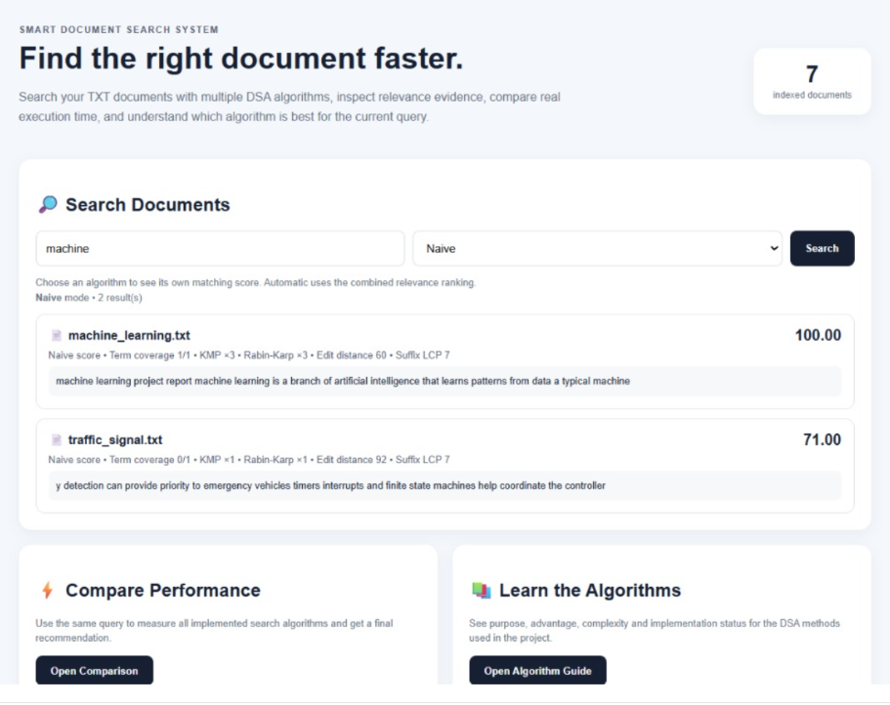
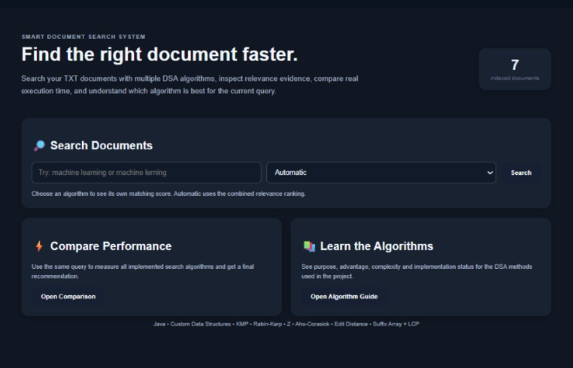
Results & Screenshots — Search Output
11
Smart Document Search System • PBL Review • 15

Slide 16
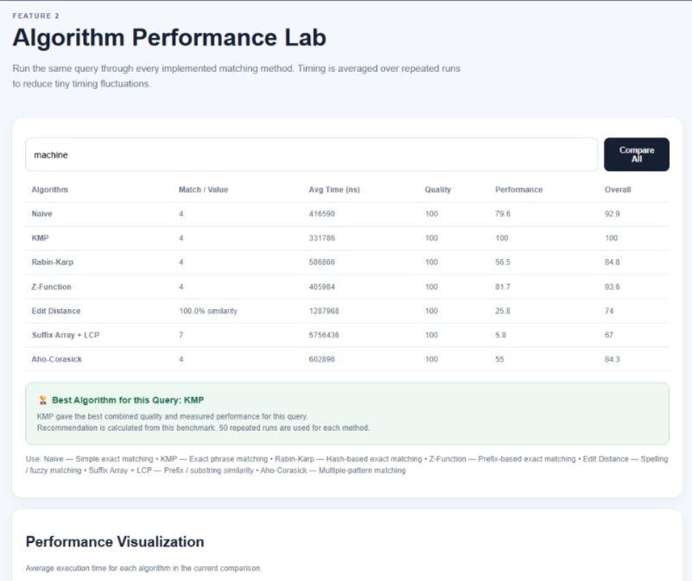
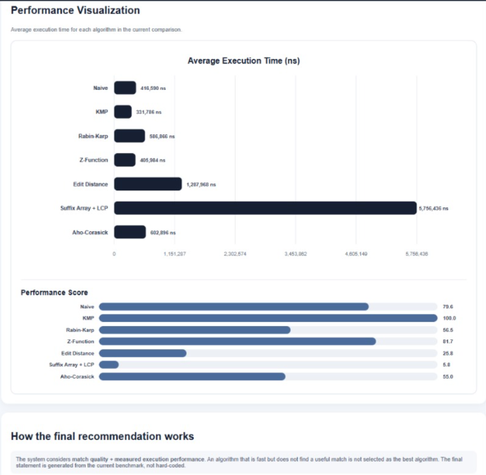
Results & Screenshots — Performance Comparison
11
Smart Document Search System • PBL Review • 16

Slide 17
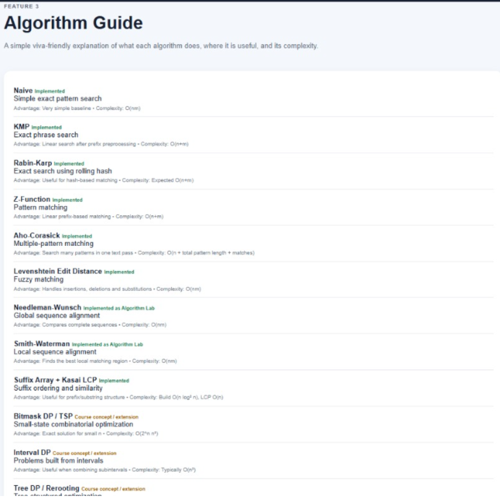
Results & Screenshots — ALGORITHM GUIDE
11
Smart Document Search System • PBL Review • 17

Slide 18
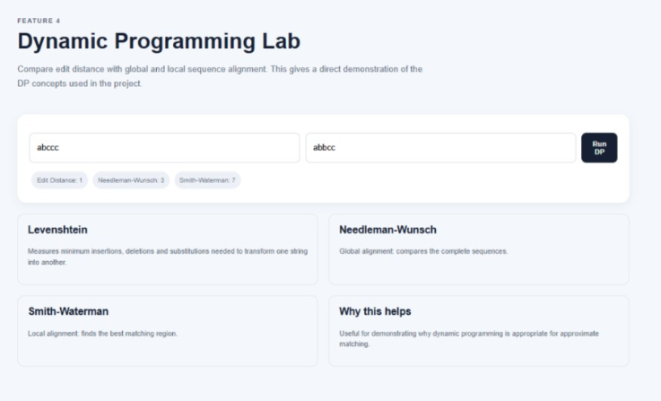
Results & Screenshots — DP LAB
11
Smart Document Search System • PBL Review • 17

Slide 19
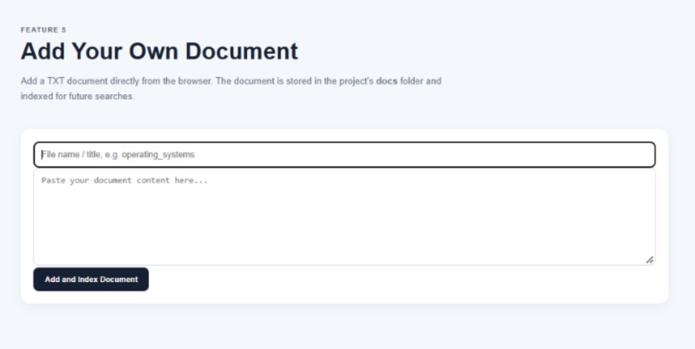
Results & Screenshots — DOCUMENT ADDING
11
Smart Document Search System • PBL Review • 17

Slide 20
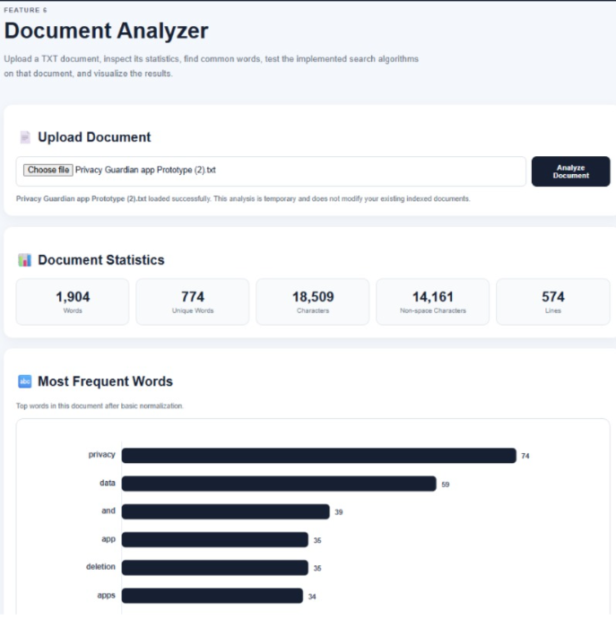
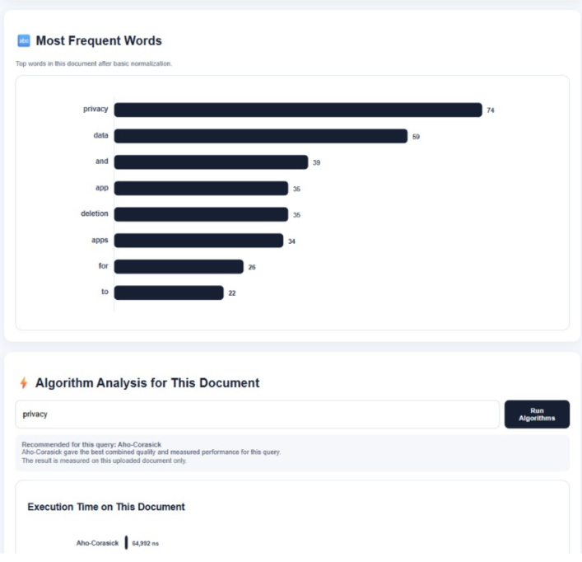
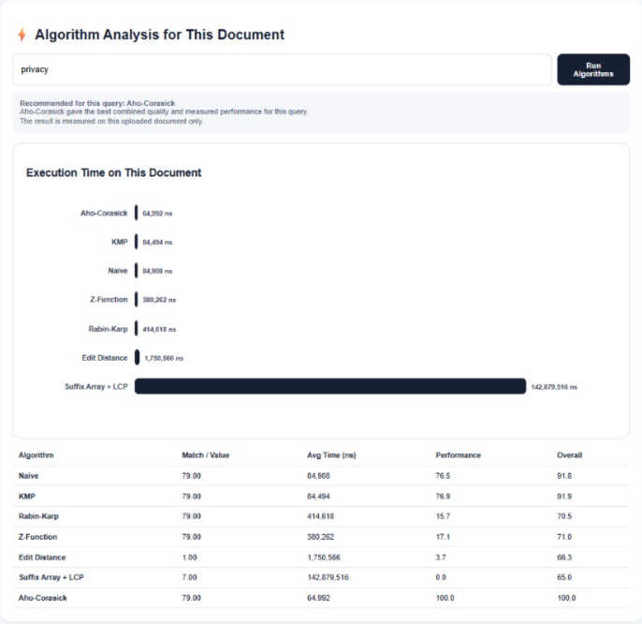
Results & Screenshots — DOC ANALYZER
11
Smart Document Search System • PBL Review • 17

Slide 21
Performance Observations
11
Query | Observed top result | Observation
machine learning | machine_learning.txt — 110.00 | Exact term coverage and phrase signals dominate.
machine lerning | machine_learning.txt — 46.56 | Fuzzy matching surfaces the intended document despite the typo.
graph algorithms | data_structures.txt — 110.00 | Both query terms are covered with exact phrase evidence.
database indexing | database_indexing.txt — 110.00 | Exact query strongly identifies the target report.
traffic signal | traffic_signal.txt — 110.00 | Exact domain phrase produces the strongest relevance.
Smart Document Search System • PBL Review • 18

Slide 22
Testing — Test Cases & Results
12
Test case | Input | Expected / observed result
Exact phrase | machine learning | machine_learning.txt ranked first; KMP ×3 and Rabin-Karp ×3.
Multi-term | graph algorithms | data_structures.txt ranked first with 2/2 term coverage.
Misspelling | machine lerning | machine_learning.txt still surfaced through fuzzy similarity.
Indexing concept | database indexing | database_indexing.txt ranked first.
Controller concept | traffic signal | traffic_signal.txt ranked first.
Unit tests | KMP / RK / Edit Distance / Suffix Array | Covered by TestAlgorithms.java.
Smart Document Search System • PBL Review • 19

Slide 23
Advantages
13
• Explainable retrieval — users can see why a document was ranked.
• Handles both exact and approximate queries.
• Demonstrates multiple DSA concepts in one practical application.
• Custom indexing reduces repeated full-document scanning for term candidates.
• Algorithm comparison makes time/quality trade-offs measurable.
• Dependency-free core is easy to compile, inspect and demonstrate in a viva.
Smart Document Search System • PBL Review • 20

Slide 24
Applications
14
Academic repositories
Find reports, notes and project documents by remembered content.
Knowledge bases
Retrieve internal technical notes when exact wording is unknown.
Document management
Locate TXT-based records without depending on filenames.
Learning platforms
Demonstrate how exact and fuzzy retrieval behave on educational content.
Prototype IR systems
Serve as a transparent DSA-oriented baseline before adding larger search stacks.
Smart Document Search System • PBL Review • 21

Slide 25
Challenges Faced
15
Challenge | How the project addresses it
Balancing multiple matching signals | Uses a transparent weighted score and exposes each component.
Approximate wording / typos | Levenshtein DP adds fuzzy evidence rather than relying only on exact matches.
Keeping DSA contribution visible | Core algorithms are implemented directly in Java instead of hidden behind a search library.
Performance comparison noise | BenchmarkService repeats measurements and reports actual System.nanoTime() values.
Scope vs. dependencies | Current runnable ingestion stays TXT-only so the DSA core remains dependency-free.
Smart Document Search System • PBL Review • 22

Slide 26
Future Enhancements
16
• PDF/DOCX extraction adapters and OCR for broader document ingestion.
• Aho-Corasick for efficient multi-pattern queries in the retrieval pipeline.
• BM25-style or learned ranking for more mature information retrieval.
• Cross-document suffix structures and compressed postings/indexes.
• Multilingual tokenization for Indian-language and mixed-language corpora.
• Web interface, larger corpus, benchmarking and parallel preprocessing.
Smart Document Search System • PBL Review • 23

Slide 27
Conclusion
• Smart Document Search demonstrates how advanced DSA algorithms can solve a practical information-retrieval problem.
• The system combines indexing, string matching, dynamic programming, suffix structures and ranking.
• The output is fast enough for a classroom-scale corpus and, importantly, explainable.
• The project provides a strong foundation for multi-format ingestion, multilingual search, richer ranking and larger-scale benchmarking.

Slide 28
References
17
• Knuth, D. E., Morris, J. H., & Pratt, V. R. (1977). Fast pattern matching in strings. SIAM Journal on Computing, 6(2), 323–350.
• Rabin, M. O., & Karp, R. M. (1987). Efficient randomized pattern-matching algorithms. IBM Journal of Research and Development, 31(2), 249–260.
• Levenshtein, V. I. (1966). Binary codes capable of correcting deletions, insertions, and reversals of digits. Soviet Physics Doklady, 10, 707–710.
• Kasai, T., Lee, G., Arimura, H., Arikawa, S., & Park, K. (2001). Linear-time longest-common-prefix computation in suffix arrays. CPM 2001.
• Oracle. Java SE Documentation — Java Platform Standard Edition. https://docs.oracle.com/en/java/
• Project source files and documentation: Smart_Document_Search_System_PBL_Report.docx, README.md, and source code in the attached project archive.
Smart Document Search System • PBL Review • 25

Slide 29
Thank You
Smart Document Search System
Fast • Fuzzy • Explainable • DSA-driven
PBL Review Presentation

